Slide 1
Cornerstones of Peer Support
Module 4
Notes:
Trainer Manual
Module 03: History of Peer Support © 2023 PeerWorks
This training program is designed to be accessible to all trainers, and ensure that all participants receive the same quality of education regardless of specific trainers’ background and experience.
This manual is a living document and should be understood as a set of guidelines, not as a fixed script. Feel free to adapt the language to your style of presentation. We also recognize that language is always changing; please update terminology when necessary. The synchronous sessions should be dynamic, engaging experiences.
TRAINER
Welcomes everyone and states the topic of today’s module.

Slide 2
Land Acknowledgement
Module 4 – Cornerstones of Peer Support
[ADD TRAINER’S LAND ACKNOWLEDGEMENT HERE]
Notes:
TRAINER’S LAND ACKNOWLEDGEMENT

Slide 3

Housekeeping
Module 4 – Cornerstones of Peer Support
Please mute yourself if you are not speaking.
Feel free to include your pronouns in your Zoom Name.
Use Zoom reaction tools, chat box, hands up, etc.
Be prepared to have video on at all times; as such, please be appropriately dressed and limit distractions.
Contribute to the conversations out loud and in the chat box.
If someone has already shared what you were going to say, lower your hand and put “agree” in the chat.
Notes:
COORDINATOR
Read out Housekeeping slide.

Slide 4
Expectations
Module 4 – Cornerstones of Peer Support
Arrive on time.
Help us create a confidential, non-judgmental space (no screenshots or recordings).
Please keep your phones on silent.
Avoid cross-talk and side-talk.
Learn from each person’s perspective.
Language – please bring new language to us as we recognize that language is ever-changing.
Have fun!
From the group:
[ADD PARTICIPANT ADDITIONS, IF ANY]
Notes:
COORDINATOR
Read out Expectations slide.

Slide 5
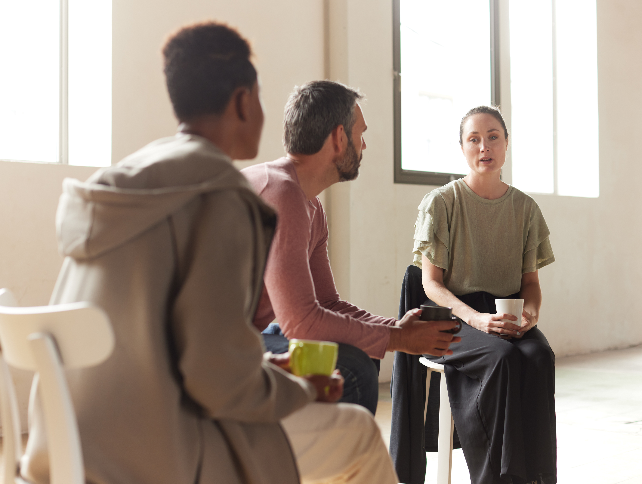
Module 4 – Cornerstones of Peer Support
What is your name?
What is one thing you’re proud of?
Notes:
TRAINER
“What is one thing you’re proud of?”
As the trainers, feel free to go first. Keep it brief and thank people for sharing.
The assigned homework reflected on stigma and self-stigma, and this question offers an opportunity for participants to reflect on more positive experiences.
Once everyone has had the opportunity to share, you can ask how the homework assignment went. If there were common threads in the homework, you can draw attention to them and ask if anyone would like to share something they discovered by doing the assignment.

Slide 6
Module Overview
Module 4 – Cornerstones of Peer Support
In Module 4 we will be learning about the Cornerstones of Peer Support: Self Awareness, Self Responsibility, Self Care and Support.
You will be invited to consider the importance of each cornerstone in relation to your life, personal journey, as well as within your role as a Peer Supporter.
By working the four cornerstones, Peer Supporters can exemplify Recovery/Wellness for our Peers.
Notes:
TRAINER
Read the Module Overview and Learning Objectives out loud or invite a participant to read it out loud.

Slide 7
Learning Objectives
Module 4 – Cornerstones of Peer Support
Through the successful completion of Module 4 you will be able to:
Identify the four cornerstones of Peer Support.
Illustrate how each of these cornerstones can be implemented and how they benefit the Peer Support relationship.
Notes:
TRAINER
Read the Module Overview and Learning Objectives out loud or invite a participant to read it out loud.

Slide 8
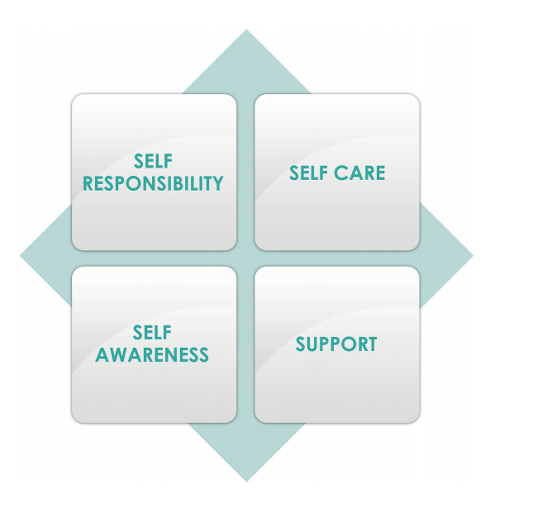
Notes:
TRAINER
“The Four Cornerstones of Peer Support are: Self Awareness, Self Responsibility, Self Care and Support. We believe that the Peer Supporter’s commitment to embracing and applying the approach to Peer Support within themselves is key in becoming a Peer Supporter. The best way for you, as a Peer Supporter, to support a Peer in moving through life challenges, living life well and realizing their wishes, is to exemplify the same within your own life.
Peer Supporters seek opportunities to learn about themselves. They are open to receiving constructive encouragement as well as feedback that supports their development of the attributes, knowledge and skills essential to the delivery of Peer Support within the Peer Supporter role.”

Slide 9
Self-awareness
Module 4 – Cornerstones of Peer Support
Self awareness is a deep understanding of who you are; a sense of knowing who you are – including your history, experiences, values, preferences, and limits. Self awareness involves tuning into yourself, becoming acquainted with yourself, understanding yourself, forgiving yourself, loving yourself for who you are and who you want to be.
Notes:
TRAINER
“Now we are going to go over the four cornerstones in more detail. The first is Self Awareness.”
Read slide or invite a participant to read the slide.
“The homework for this synchronous session will be a reflection on self-awareness. As we move through the four cornerstones, start thinking about how you exemplify self-awareness in your life.”
Start a discussion about self-awareness. Think about what it means to be self-aware. It can be asking yourself “why am I having this emotional response?” or “What are my strengths and what are areas I would like to develop?” It focuses on physical, emotional, mental, and spiritual.

Slide 10
Self-responsibility
Module 4 – Cornerstones of Peer Support
Self Responsibility is being accountable for one’s self or taking charge of one’s self. Self responsibility includes self discipline and self management.
How have you taken responsibility for yourself in your own personal journey?
How can you exemplify this responsibility in your work as a Peer Supporter?
Notes:
TRAINER
Read the slide and ask the two questions on the slide to start a group conversation.

Slide 11
Self care
Module 4 – Cornerstones of Peer Support
Self care involves a willingness to extend the same compassion to yourself as you do to others. Self care includes a commitment to nurturing your physical, emotional, mental and spiritual being. Self care involves a deep knowing of your priorities as well as your limits; a willingness to take actions that demonstrates your commitment to yourself.
Notes:
TRAINER
Read the slide on self-care or ask a participant to read it.
Invite people to share the methods of self-care that they do. Feel free to unmute yourself or add it to the chat box.
Other points that you can bring up after you read the slide:
We are reaching a point where there have been lots of discussions about self-care, but people don’t often talk about the hard work of self-care. Some of the things that we do for self-care, such as taking a break and reading our favourite book, don’t seem difficult to do, but sometimes they are. We can feel guilty for taking time for ourselves, even when we know it’s important for our mental health. Additionally, some self-care can be challenging. Speaking to a Peer Supporter can be great for our mental health, but that doesn’t mean it’s easy. It’s okay to acknowledge that these things can be hard and that we sometimes need to reframe them in our mind.
It can help to make a self-care plan before you need that self-care. Make a list of what helps you when you feel overwhelmed or need to recharge? What do you do before you even get to that point to maintain your physical and emotional wellbeing? Think back to the 7 Dimensions of Wellness. These things can all become part of our selfcare plan.
Practicing selfcare will be the homework of one of the later synchronous sessions, when we start to discuss heavier topics, so start thinking about your selfcare needs now.

Slide 12

Notes:
“Self-care can include self-talk. How do you speak to yourself? What does the voice in your head sound like? Would you speak this way to your best friend or a Peer you support?
Self-talk is your internal dialogue and it can reveal your beliefs, thoughts and concerns. It can be negative or positive. It can encourage you or upset you.
Positive self-talk can build your confident, promote self-love, help you cope with stress, motivate you and improve your attitude.”
At this point you should be at least halfway through the time allotment.

Slide 13
How can we change these examples of negative self-talk into positives?
Module 4 – Cornerstones of Peer Support
I’m a bad person.
I can’t do anything right.
I am not as good as other people.
Notes:
COORDINATOR
*Note: this slide is animated. Each of the 3 examples will come up on the screen one at a time.
Group activity to change these negative examples of self-talk into positives. Work through the first one together and then give everyone 5 minutes alone to come up with transformations for the 2 and 3 examples.
Some possible transformations could be:
I’m a good person. I’ve done things wrong in the past, but I’m working on myself.
I made a mistake, but it doesn’t define who I am. Everyone makes mistakes, and that’s how you learn.
Like everyone else, I have my strengths and weaknesses. There are things that I am really good at and things that I am working to improve. I don’t need to be perfect to be worthy, respected or liked.
These are the kinds of transformations that you can help your Peer work through as a Peer Supporter. However, this work will be more successful if you exemplify positive self-talk yourself. Your positive self-talk can set a good example for your peer.

Slide 14
Support
Module 4 – Cornerstones of Peer Support
Supports include people, places, activities and things. Support is a key ingredient in life, personal journeys, and peer support. The reciprocity of peer support includes receiving as well as giving support.
Do you find it easier to give or receive support? Why?
Notes:
TRAINER
*Note: This slide is animated. The question “Do you find it easier to give or receive support? Why?” will come up after reading the first paragraph on the slide.
Read the slide or invite a participant to read the slide. Ask the question (this will pop up on the slide as indicated above) to the group and encourage discussion. Some people find it hard to be vulnerable and ask or accept support. Reaching out or accepting support isn’t a weakness. It can be tempting to think “I can do it all myself” but supporting others and receiving support is community care. Community care and self-care are interconnected and complement each other.

Slide 15
Isolation
Module 4 – Cornerstones of Peer Support
Studies have linked social isolation with negative consequences to physical and mental health including depression, poor sleep quality, impaired physical function, accelerated cognitive decline, poor cardiovascular function, and impaired immunity. These impacts were seen at every stage of life.
(Philosophical Transactions of the Royal Society B, Vol. 370, No. 1669, 2015)
In 2019 a public health researcher with the American Cancer Society, analyzed data from more than 580,000 adults and found that social isolation increases the risk of premature death from every cause for every race.
(American Journal of Epidemiology, Vol. 188, No. 1, 2019)
Notes:
TRAINER
“The four cornerstones of Peer Support can help reduce isolation and its impacts. We all felt the impacts of isolation during the COVID pandemic, and in a post-COVID world we might still feel the effects of isolation, especially in more remote areas. Isolation can have a detrimental impact on people with experiences of mental health and addictions.”
Invite someone to read the slide. They don’t have to read the citations out loud.

Slide 16
Methods to Combat Isolation
Module 4 – Cornerstones of Peer Support
Reach out to family and friends
Join a club or a community. It could be related to a topic or activity that interests you, such as a book club or a bowling team. It could also be online or in person. You could also join a spiritual community, such as a mosque, church, temple or synagogue. Become a volunteer at a organization that you are passionate about.
Get a pet, volunteer at a shelter, or offer to walk a friend’s pet.
Stay active and go outdoors. Go for a walk, try yoga or biking, visit a park or stretch.
Start a project or craft. Write in a journal, learn how to knit, or decorate your home.
Notes:
TRAINER
Read out the slide and invite participants to share more of their methods for combating isolation. The methods can be social, but don’t have to involve other people. Different things work for different people.

Slide 17
Paired Exercise
Module 4 – Cornerstones of Peer Support
Pair off with another person in the training. Take a moment to introduce yourself, reintroduce yourself and/or check in with one another before you begin the exercise.
Discuss your challenges and strengths in relation to each of the four cornerstones of Peer Support. Take turns with one person sharing first, and the other listening attentively. Then switch.
Record what you believe is your strongest cornerstone as well as the cornerstone that you intend to further invest in developing.
Notes:
COORDINATOR
Read out the instructions for the paired activity. Ask if anyone has any questions. This should take approx. 5-10 minutes.
Come back to the group and ask each group what they considered their strongest cornerstone and which they needed to develop. See if there is any overlap. If so, discuss why. Perhaps there are shared challenges to that particular cornerstone. Those who have listed that cornerstone as one of their strengths can share as well. As we share we can learn from each other, especially if our area to develop is another person’s strength and vice versa.
Note: After we have done this training a few times we might be able to see a pattern and create an infographic or we might find that there are no patterns.

Slide 18
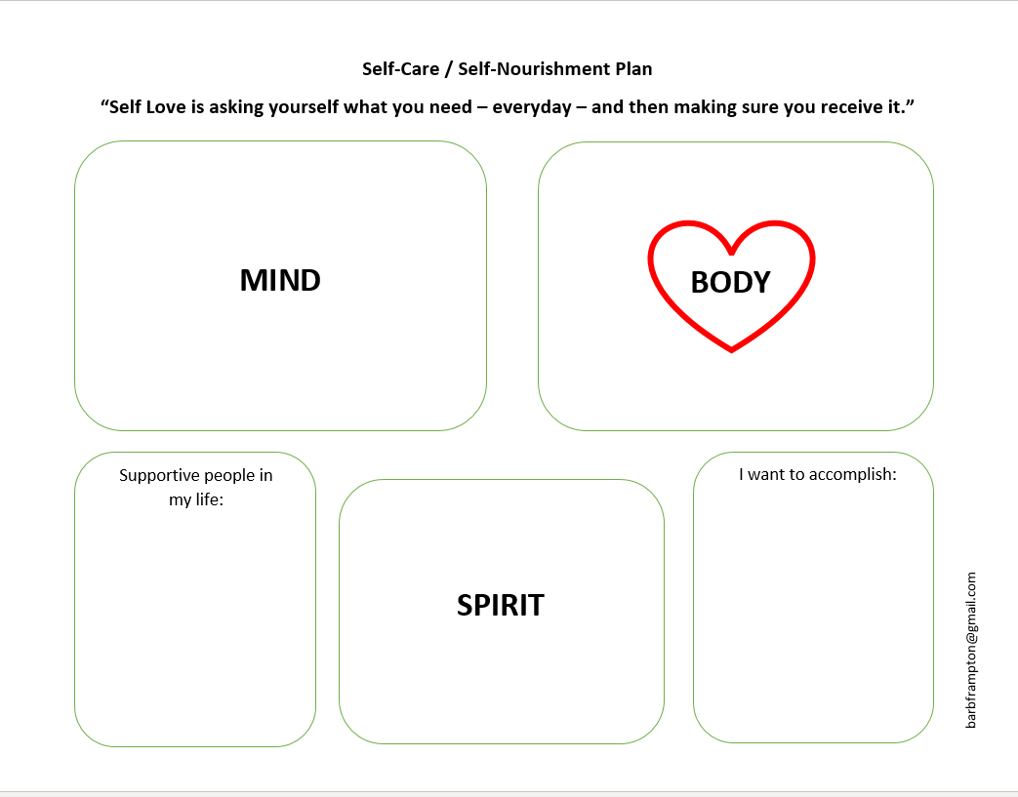
SELF-CARE
Notes:
TRAINER
These are examples of self-care plans.

Slide 19
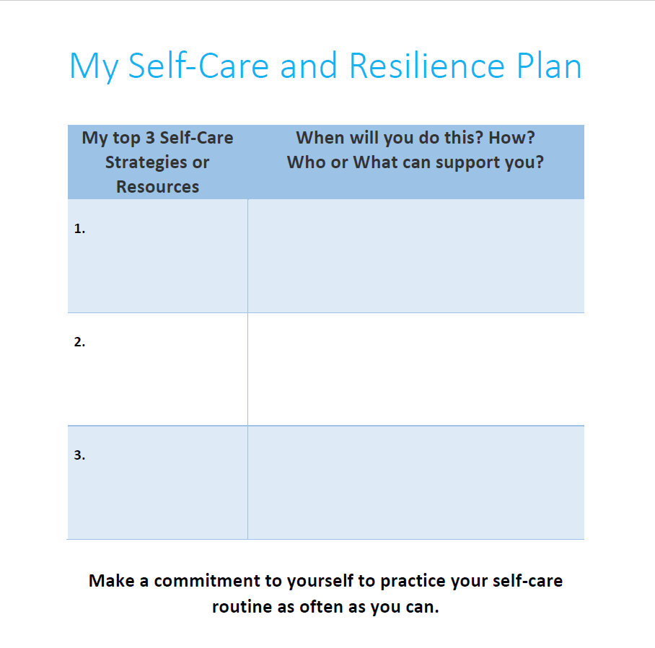
Notes:
TRAINER
These are examples of self-care plans.

Slide 20
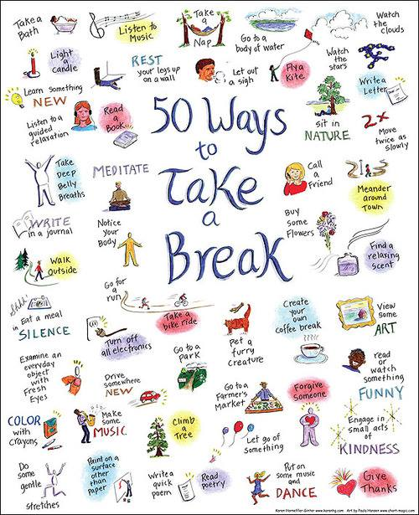
SELF-CARE
Notes:
COORDINATOR
These are examples of self-care activities.

Slide 21
Homework
Module 4 – Cornerstones of Peer Support
For Next Time:
Write a short reflection that will be submitted before the next module. It should answer the following questions:
Describe what you believe is your strongest cornerstone
Describe the cornerstone that you intend to further invest in developing. How will you do this?
To be submitted before the next session.
Notes:
COORDINATOR
Read out the homework for next week. Thank everyone for their time and ask if there are any final comments/questions.

Slide 22
Thank You
Notes:
TRAINER
Thank everyone for their time and ask if anyone has any final comments or questions that they want to bring forward.

